Slide 1
Grammar
Language: A language is a collection of strings of finite length all constructed from a finite alphabet of symbols.
Grammar: Grammar refers to a formal system that defines how strings in a language are constructed.
A grammar is defined as G = (N, T, P, S) where
V or N is a finite nonempty set of variables.
Σ or T is a finite nonempty set of Terminals.
P is a finite set of production rules such that α → β, where α and β are strings on V U Σ. And α has at least one symbol from V.
S is a special variable i.e. an element of V called the start symbol and
V ∩ Σ = φ

Slide 2
Observe the following regarding the production rules:
Reverse substitutions is not permitted.
For example, if S → AB is a production then we can place S by AB but we cannot replace AB by S.
No inversion operation is permitted.
For example, if S → AB is a production then, it is not necessary that AB → S is a production.

Slide 3
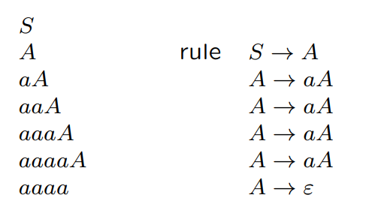
Example : • V = {S, A, B}, • Σ = {a, b}, • R = {S → A, S → B, B → bB, A → aA, A → ε ; B → ε}, • S is the start symbol
Words generated by Grammar: aaaa is in the language generated by the grammar we have just described:

Slide 4
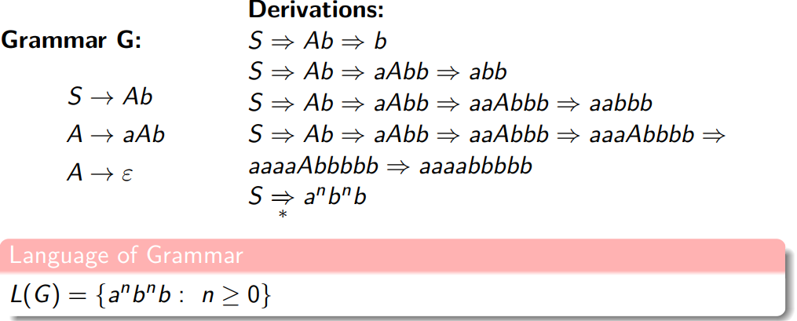
Derivation
The production rules are used to derive the certain strings from start symbol and at every step we are replacing or substitute the value of variable in right hand side the entire process is called derivation. And whatever intermediate string obtain at every step, these are called sentential form or sequential form.

Slide 5
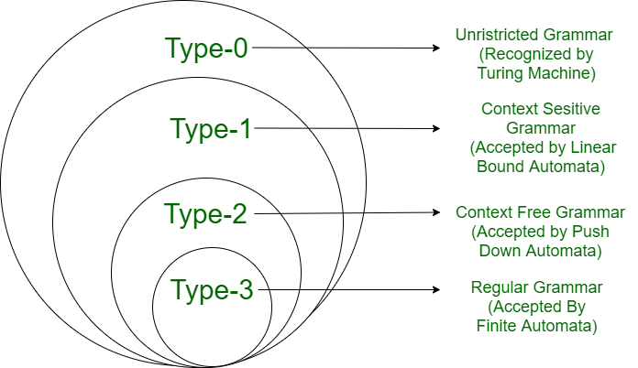
Chomsky's Hierarchy (Type of Grammar )
According to Chomsky hierarchy, grammar is divided into 4 types as follows:
Type 0 is known as unrestricted grammar.
Type 1 is known as context-sensitive grammar.
Type 2 is known as a context-free grammar.
Type 3 Regular Grammar.

Slide 6
Type of Grammars
Grammar Type | Grammar Accepted | Language Accepted | Automaton
Type 0 | Unrestricted grammar | Recursively enumerable language | Turing Machine
Type 1 | Context-sensitive grammar | Context-sensitive language | Linear-bounded automaton
Type 2 | Context-free grammar | Context-free language | Pushdown automaton
Type 3 | Regular grammar | Regular language | Finite state automaton

Slide 7
Type 0 Grammars: Unrestricted Grammar
Type-0 grammars include all formal grammar.
Type 0 grammar languages are recognized by Turing machine.
These languages are also known as the Recursively Enumerable languages.
Grammar Production in the form of α → β where
α is ( V + T)* V ( V + T)*
V : Variables
T : Terminals.
β is ( V + T )*
For example:
Sab --> ba
A --> S
Here, Variables are S, A, and Terminals a, b.

Slide 8
Type 1 Grammar: Context-Sensitive Grammar
Type-1 grammars generate context-sensitive languages.
The language generated by the grammar is recognized by the Linear Bound Automata.
First of all, Type 1 grammar should be Type 0.
These grammars have rules of the form αAβ → αγβ with A is a non-terminal and α, β and γ strings of terminals and non-terminals.
Here length of LHS of production <= length of RHS of production
The strings α and β may be empty, but γ must be non-empty.
The rule S →ε is allowed if S does not appear on the right-side of any rule.
For Example:
S --> AB
AB --> abc
B --> b

Slide 9
Type 2 Grammar: Context-Free Grammar
Type-2 grammars generate context-free languages.
The language generated by the grammar is recognized by a Pushdown automata.
First of all, it should be Type 1.
The left-hand side of production can have only one variable and there is no restriction on β .
The productions must be in the form A → γ where A ∈ N (Nonterminal) and γ ∈ (T∪N)*.
For example:
S --> AB
A --> a
B --> b

Slide 10
Type 3 Grammar: Regular Grammar
Type-3 grammars generate regular languages.
These languages are exactly all languages that can be accepted by a finite-state automaton.
Type 3 is the most restricted form of grammar.
Only one non-terminal can appear on the right side of any production
A Regular Grammar is one that is either Right Linear or Left Linear but not both at the same time.
The rule S → ε is allowed if S does not appear on the right side of any rule.
A → a or A → aB where a is terminal and A,B are non-terminal
Or
A → a or A → Ba where a is terminal and A,B are non-terminal

Slide 11
Linear grammar
A linear grammar is a restricted context-free grammar where each production has at most one non-terminal on the right-hand side, appearing either at the far left or far right.
making it equivalent to regular grammars.
These grammars are used to define regular languages and are recognized by finite automata.
S → aA
A → aB
B → Bb

Slide 12
Right Linear Grammar (RLG)
A right linear grammar is a linear grammar in which the non-terminal symbol always occurs on the right side.
In this type of grammar all the productions or production rules in P are of one of the following forms:
B → a (Where B is a variable or non-terminal in V and a is terminal in Σ)
B → aC (Where B and C are in a Variable V and a is terminal in Σ)
B → ε (Where B is a variable in V and ε denotes the empty string i.e. the string of length 0)
RLG is equivalent to DFA (Deterministic Finite Automata) and NFA (Nondeterministic Finite Automata)

Slide 13
Left Linear Grammar (LLG)
A left linear grammar is a linear grammar in which the non-terminal symbol always occurs on the left side.
In this type of Grammar all the productions or production rules in P are of one of the following forms
A → a (Where A is a non-terminal in V and a is a terminal in Σ)
A → Ba (Where A and B are in V and a is in Σ)
A → ε (Where A is a variable in V and ε is the empty string)
LLG is not directly compatible with DFA/NFA but can be converted to RLG.

Slide 14
Regular grammars
A Regular Grammar is one that is either Right Linear or Left Linear but not both at the same time
At most ONE VARIABLE on right side of any production.
The variable must consistently be either the rightmost or leftmost symbol of the right side of any production.

Slide 15
Example 1:
The Grammar G1 = ( { S }, { a, b }, S, P ) with P is given as
S → a b S | a
The above grammar is Right-Linear Grammar It is also Regular Grammar
The derivation of the string aba is as follow:
S ⇒ a b S
⇒ a b a
S ⇒ a b S
⇒ a b a b S
⇒ a b a b a
L(G1) can be represented as Regular Expression as
r = ( a b )* a

Slide 16
Example 2:
The Grammar G2 = ( { S, S1, S2 }, { a, b }, S, P ) with P is given as
S → S1 a b
S1 → S1 a b | S2
S2 → a
The above grammar is Left-Linear Grammar It is also Regular Grammar
The derivation of the string aab is as follows:
S ⇒ S1 a b
⇒ S1 a b a b
⇒ S2 a b a b
⇒ a a b a b
[Rule 1]
[Rule 2]
[Rule 3]
[Rule 4]
S ⇒ S1 a b
⇒ S2 a b
⇒ a a b [Rule 4]
[Rule 1]
[Rule 3]
L(G2) can be represented as Regular Expression as
r = a a b (a b)*

Slide 17
Example 3:
The Grammar G3 = ( { S, A, B }, { a, b }, S, P ) with P is given as
S → A
A → a B | ε
S2 → A b
The above grammar is not Regular Grammar
It contains both type of productions Left Linear and Right Linear Forms
The Grammar is neither Left Linear nor Right Linear It is an example of Linear Grammar
Definition:
It is Grammar in which at most one variable can occur on Right side of any productions without restriction on position of Variable
A Regular Grammar is always Linear but not all Linear Grammars are Regular Grammars

